Slide 2
Centre for pedagogical innovation
&
didactic entrepreneurship
www.c-pi.dk
Ebbe Kromann & Lasse Skånstrøm
Frederiksberg Seminarium
Copenhagen City College

Slide 4
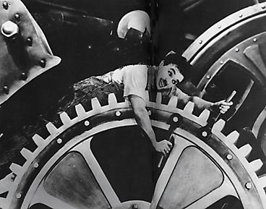

Slide 5
Putting innovation and entrepreneurship on the agenda in the Danish education system
Developing partnerships and networks between government educational institutions, private companies and research environments
Improving the relationship and cohesion between pedagogical research, development work and practice
Developing theories and methods, including tools and working methods, in cooperation with schools, municipalities, companies, and cultural institutions, etc.

Slide 6
“The Danish public school system must ensure children and youths acquire strong academic skills. But students must also learn to be innovative, break with traditional ways of thinking and see new opportunities”.
The council also stated that “In connection with the coming reform of teacher education, the relevant content descriptions for each subject must be changed to include pedagogical methods and techniques that can stimulate and develop students' innovative skills". And, “Teachers must be familiar with methods and forms of cooperation that promote innovation”.
“Students must use methods and forms of cooperation during the course which can develop the innovative skills of school pupils, including the will and ability to think creatively and take initiative in a multidisciplinary approach. Training institutions must ensure that line subjects include considerations about stimulating school pupils’ systematic work with idea development and entrepreneurship in a multidisciplinary interplay between school subjects.”

Slide 7
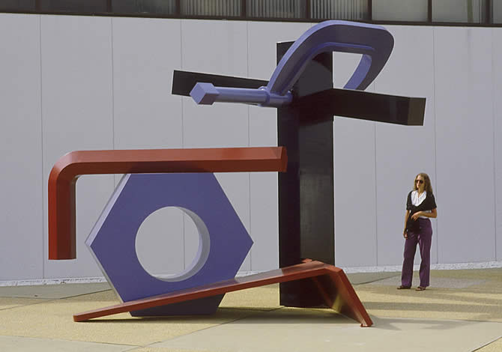

Slide 8
2 current education policy discourses
’Back to basics’
(better academic skill)
Globalisation & innovation skills
(more skills)

Slide 9
2 current didactic discourses
What is the subject and academic skill?
(core ability)
What can the subjects and academic skills be used for?
(core competencies)

Slide 11
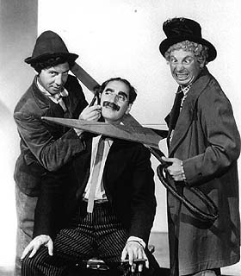

Slide 12
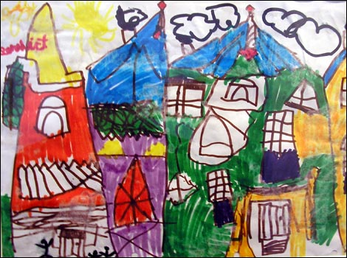
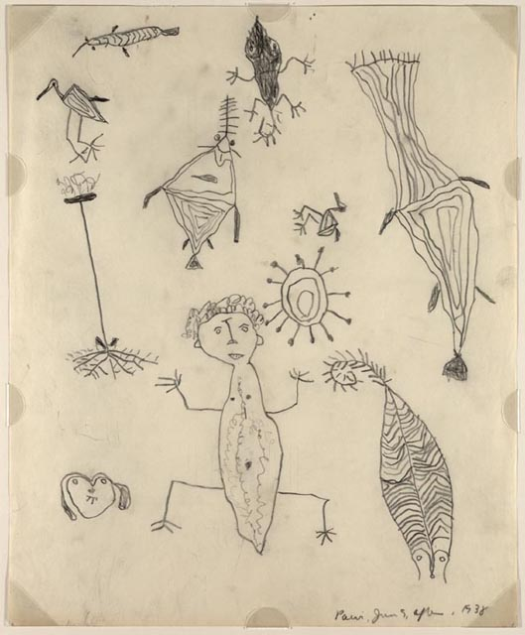
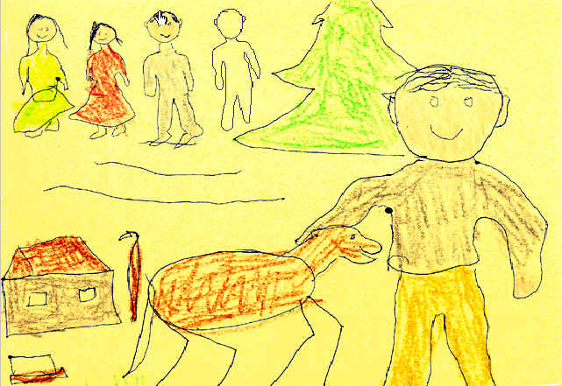

Slide 13
Aristotle
Action
’Phronesis’
Knowledge
’Episteme’
Ability
’Techne’

Slide 14
Current shifts
Knowledge
Ability
Content description
Competency description

Slide 16
Methodological shifts
Content
Form
Process
Product
Recipe
(re-ceptualisation)
Concept
(con-ceptualisation)
Reproduction
Production
Imitation
Innovation

Slide 17
Philosophical shifts
Subject
(Subject priority)
Object
(Object priority)
Subjectivity theory
(Subject philosophy)
Objectivity theory
(Object philosophy)
Self-ness
Identity
Continuity
Other-ness
Non-identity
Break

Slide 19
Applied skills – an example
Theory
What is mathematical knowledge?
Text
What is mathematics?
Transformation
Context
What can mathematics be used for?
Practice
What is mathematical ability?

Slide 20
A pedagogical model
Knowing
(knowledgement)
Being
(qualities)
Transformation
Doing
(competencies)
Being able to
(skills)

Slide 21
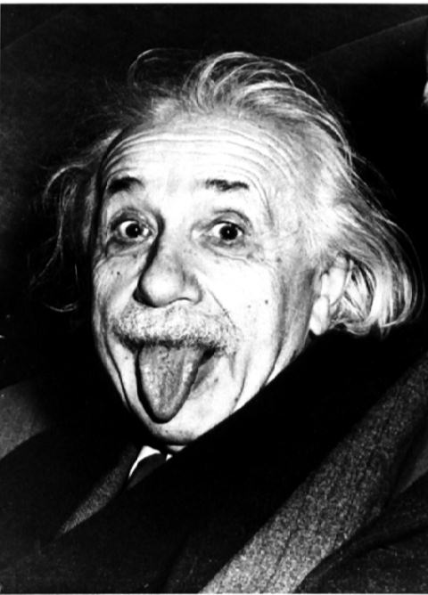
"Imagination is more important than knowledge.
Knowledge is limited. Imagination encircles the world."

