Slide 1
Innovation Education and Entrepreneurship in the Icelandic School system
“...this was just connected to everything”
A seminar on innovation education and entrepreneurship in Iceland and Denmark
Svanborg R. Jónsdóttir
Ph.D. Student at the Iceland University of Education
Notes:
The name of the seminar comes from a researchinterview with a 16 year old girl in an icelandic compulsory school where she was explaining what kind of subject innovation education was according to her experience.

Slide 2
THE ICELANDIC SCHOOL SYSTEM
Higher education
(universities and non-universities)
Age
School year
20
Specialised
schools
14
Comprehensive schools
Industrial-vocational schools
Grammar schools
Vocational schools
16
10
Compulsory schools
(Primary and lower secondary education)
6
1
Open access
Access to a specific study programme / school, subject to specific requirements
Pre-schools
Notes:
A high percentage of the icelandic workforce has no further education or around 30%

Slide 3
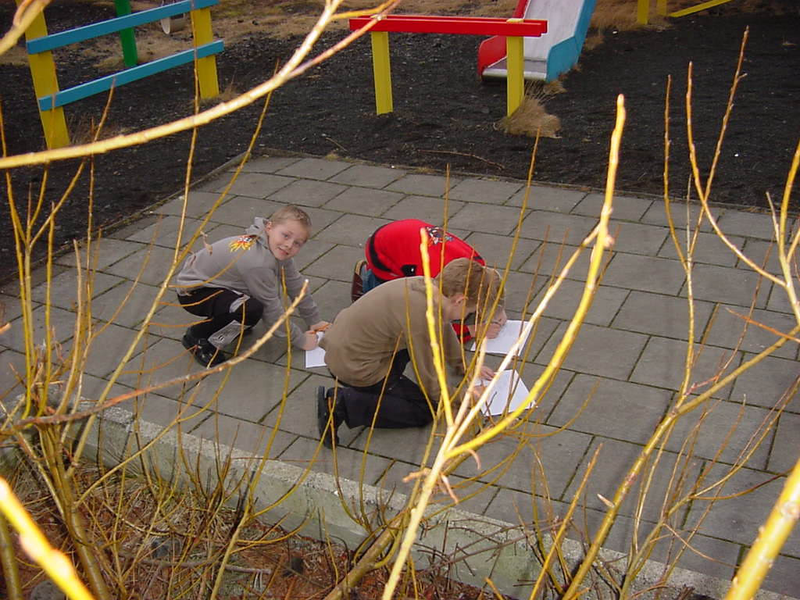
Innovation and Entrepreneurship
Innovation and Entrepreneurship
Two sides of the same coin
Ideation is the foundation that initiative and entrepreneurship are built on
Entrepreneurship develops initiative and productivity
Or directly connected!

Slide 4
Short history of IE in Iceland
Early 1990s
Innovation Contest for Icelandic compulsory schools from 1992 (last year 52 schools of 198)
Paul Jóhannsson and coworkers – model from Sweden
Innovation education within schools:
Guðrún Þórsdóttir, Gísli Þorsteinsson og Rósa Gunnarsdóttir
Development project:
Foldaskóli in Reykjavík hosted the development of the pedagogy and methods and preparing the first teaching materials, Teaching materials: Guðrún – Rósa og Gísli
1999
Innovation Education – introduced into the National Curriculum
Late 1990s onwards
Inservice courses for teachers
Rósa Gunnarsdóttir,
PhD in pedagogy and education defining Innovation Education in 2001
InnoEd a European project: Diploma in Innovation Educatin
Masters Thesis, research on IE
Two PhD research projects underway Gísli and Svanborg

Slide 5
Innovation education
“A curriculum subject that involves inventing new objects, redesigning things that already exist and building for change to enhance and improve the conditions of social life.
It encourages children and young people to look carefully and critically at the material world that surrounds them. It teaches, through active engagement, that the material world has been made by people and can be altered, changed and improved. It develops critical thinking and practical skills in design and technology and in marketing and enterprise.”
Dr. Catherine Burke, Leeds University

Slide 6
The Ideology
Everyone can change their environment
Humans are the creators of their own human environment…

Slide 7
Strands of teaching
Search for needs
Solution work
Innovation Education Notebook
Drawing/Language
Models and prototypes
World of work
Notes:
The main activities in ie are built on these strands
If you look at these core activities you can see that many subjects and various kinds of knowledge are used in ie
Science, inventors methods, arts, icelandic, slojd (woodshop), the world outside, world of work and experience from personal life.

Slide 8
The Emergence of a New School subject. Innovation Education in Compulsory schools in Iceland Master’s research from the University of Iceland 2005.
Three main questions
What is Innovation Education and how did it emerge in the Icelandic school system?
What is the status of the implementation of IE in Icelandic compulsory schools?
Which factors can be seen to hinder or strengthen IE in schools?
Notes:
Carried out my research-

Slide 9
The implementation of IE in Icelandic Compulsory Schools Statistical survey schools in 2003-2004
IE was taught formally in under 10% of Icelandic Compulsory schools
60%
54%
50%
Ratio of Icelandic compulsory schools
36%
40%
30%
20%
10%
10%
0%
1
Innovation Education lessons
IE within other subjects or as an emphasis
No Innovation Education
IE in Icelandic Compulsory Schools in 2003-2004.
Notes:
The population was 189, 131 were delivered, answers from 73. Að þessum 10 skólum meðtöldum eru svör skólanna orðin 73 og þar með tæplega 57% svörun. Niðurstaðan, miðað við þessa 73 skóla, er sú að í tæplega 10% íslenskra grunnskóla var kennd nýsköpun með formlegum hætti veturinn 2003-2004. Um 36% skóla til viðbótar telja sig vera að kenna einhverja nýsköpun, samþætta við aðrar námsgreinar eða sem áherslu í kennslu. Samtals eru þá 46% grunnskólanna með einhverja nýsköpunarkennslu að mati skólastjóra þeirra.
[1] Mismunandi var hvað lá að baki mati þeirra sem ég rannsakaði betur á þessu stigi. Einn sagðist ekki vera með neina nýsköpunarkennslu af nokkru tagi og skildi ekki hvað hann hafi verið að hugsa þegar hann svaraði því að hans skóli væri með formlega nýsköpunarkennslu. Aðrir höfðu talið eina heimsókn yfir veturinn frá utanaðkomandi nýsköpunarkennara sem formlega kennslu og enn aðrir nýbreytniverkefni sem formlega nýsköpunarkennslu.

Slide 10
Various factors influence IE the hidden curriculum the voices of teachers, administrators, ministry officials and students – and from observations
The role of the Innovation teacher – the teacher's professional philosophy
The role of the students – freedom, autonomy
School organization
The importance of school leadership and support
The culture or ethos of the school
Available teaching materials
Teacher education
The innovation contest
The reluctance to change
The status of school subjects – academic drift
Introduction of the subject to all concerning parties
Notes:
Obstacles are overturned where there is enough interest
The importance of the subject has to be acknowledged
To be able to value the quality of educational innovations or reforms you first have to get to know them
To know what it’s about you have to get to know it somehow

Slide 11
The hidden curriculum An important factor: the role of the innovation teacher
The innovation teacher must be the “flexible teacher “ The innovation teacher can tolerate the fact that no truth is absolute and the uncertainty of giving power to the students, the power of deciding what to work with and how, supports the student and creates the circumstances for learning.
The opposite type of teacher is the “square teacher “ who will not get the delicate flow of ideation to work well.
He/she wants to have the control and knows the right answers, the answers that can most easily be tested.

Slide 12
Entrepreneurship in the curriculum for upper secondary schools
Entrepreneurship was introduced in the national curriculum from 2006 within the section for business and economics studies
Before there was enough freedom to set up entrepreneurship courses within the secondary schools
Notes:
As this is a direct

Slide 13
Activities in FE
37 upper secondary schools
As curriculum 4
As Junior Achievement 10 (2006-07)
Young Entrepreneur Factory 7
www.yeffactory.com
www.jai.is
Notes:
The technological institute of Icleand – Impra innovation centre
The Young Entrepreneur Factory was a 3 year trans-national project developed to help young people aged 16 – 25 to establish their own businesses on the Northern Periphery of Europe. The project aims to help young people: • Develop their business ideas • Plan their future business development • Meet other young people and share ideas and experiences • Receive the support they need to develop their skills and talents

Slide 14
Framhaldsskólinn á Húsavík
The only FE school that introduces innovation education and entrepreneurship as a special emphasis in their school policy
We put emphasis on introducing all students to the ideology of innovation education and entrepreneurship to enhance their efficacy in spotting opportunities in daily life and take part in the formation of society. All students will have the opportunity to take part in such activities.

Slide 15
Higher Education
Entrepreneurship Education and Innovation has increased
Staff in HEI’s have increased, 2 docents, and 2 professorships in the last 5 years.
External sponsorship ...
Mainly within the economics and business faculties
In teacher education practically non- existent

Slide 16
The current situation
Foundation in the curriculum for creativity, innovation education and entrepreneurship education – in practice, scarce and isolated.
 | Nursery | Pri/ Sec |  |  | FE | HE
Innovation Education
Entrepreneurship
Economic and work-life studies (life-skills)
Notes:
Random
Dispersed
Discontinuous

Slide 17
The Future
 | Nursery | Pri/ Sec |  |  | FE | HE
Innovation Education | Creativity and innovation
Entrepreneurship
Economic and work-life studies

Slide 18
Practical and creative use of knowledge is the foundation of the knowledge society!

Slide 19
To influence the future FIKNF (www.inet.is/fiknf)
FIKNF is the association of Innovation Education and Entrepreneurship teachers in Iceland
National association
Network of information
Seminars
Teacher training
Advisory role in curriculum matters

Slide 20
FÍKNF
Founded in December 2005
Around 100 members from all levels of education
Membership is free of charge
Further information on
www.inet.is/fiknf and all the latest news on http://www.fiknf.blog.is/blog/fiknf/
If you want to join, please visit our website and register or do it here on paper!

